Slide 1

Stock viewer lite
Joey Herzer | Kyle Mataloni | Yuk Keung Wong | Abel Rodriguez

Slide 2


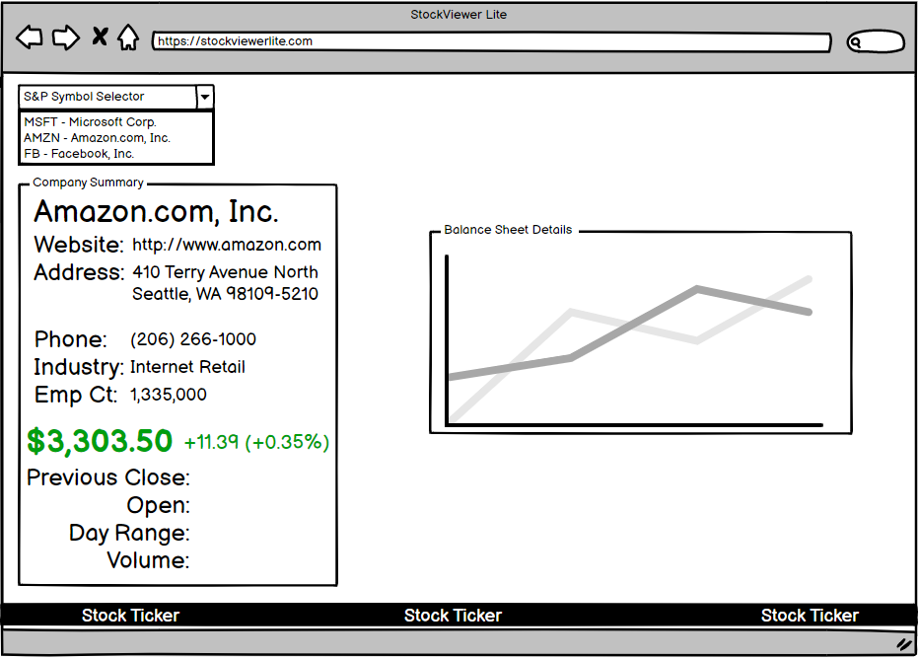
YOUR TITLE GOES HERE
OUR APPROACH
-- Searched for two data sources that would be usable together:
Yahoo Finance API
Kaggle CSV - Balance Sheet Details
-- Utilized Balsamiq to create desired wireframe
-- Identified desired technologies
AWS RDS - Postgres DB to hold CSV information
AWS Lambda - Serverless computing platform
Flask - Powers our User Interface
D3 – For Visualization
-- Used “Node.JS” - Used “PostgreSQL-Easy” module to interact w/ PostgreSQL database
SUBTITLE GOES HERE

Slide 3
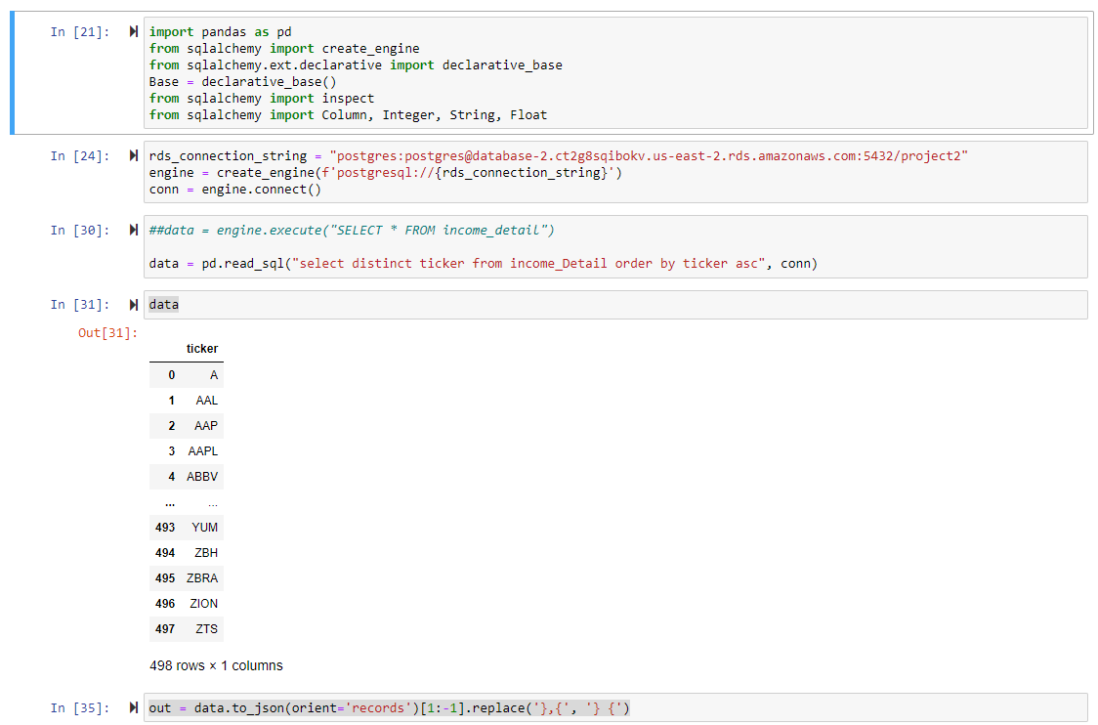
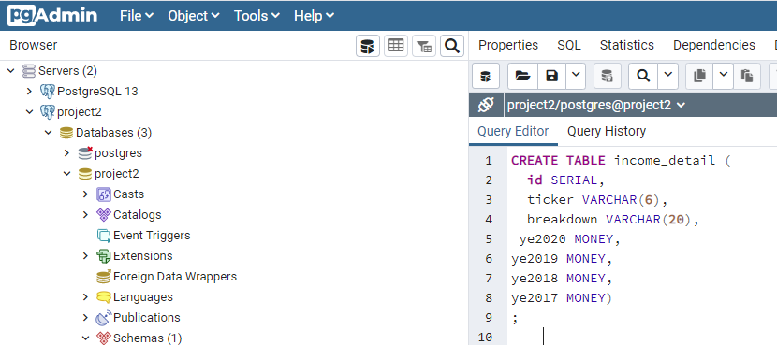
AWS – RDS Overview
Created AWS RDS to host in the cloud
Connected via AWS endpoint using PGAdmin Client
Able to create tables using PGAdmin

Slide 4
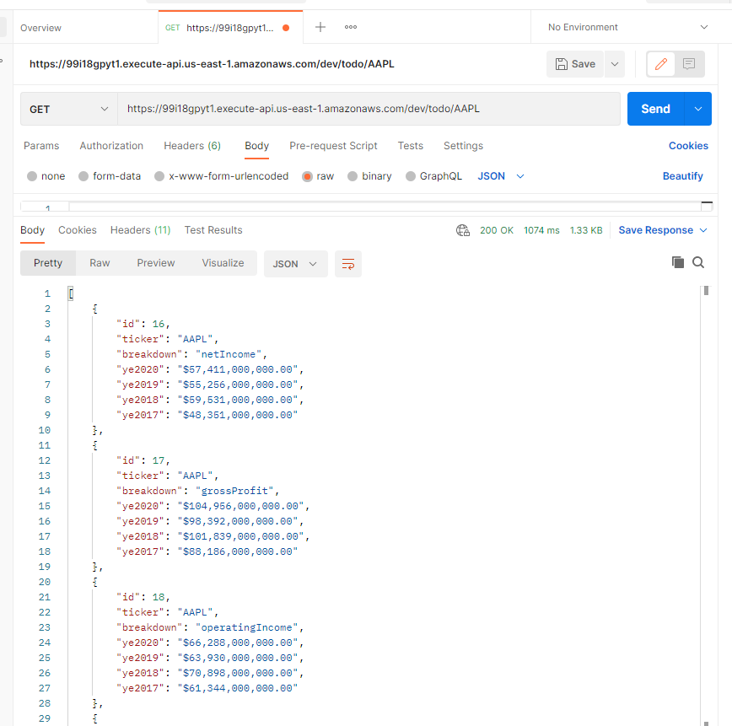
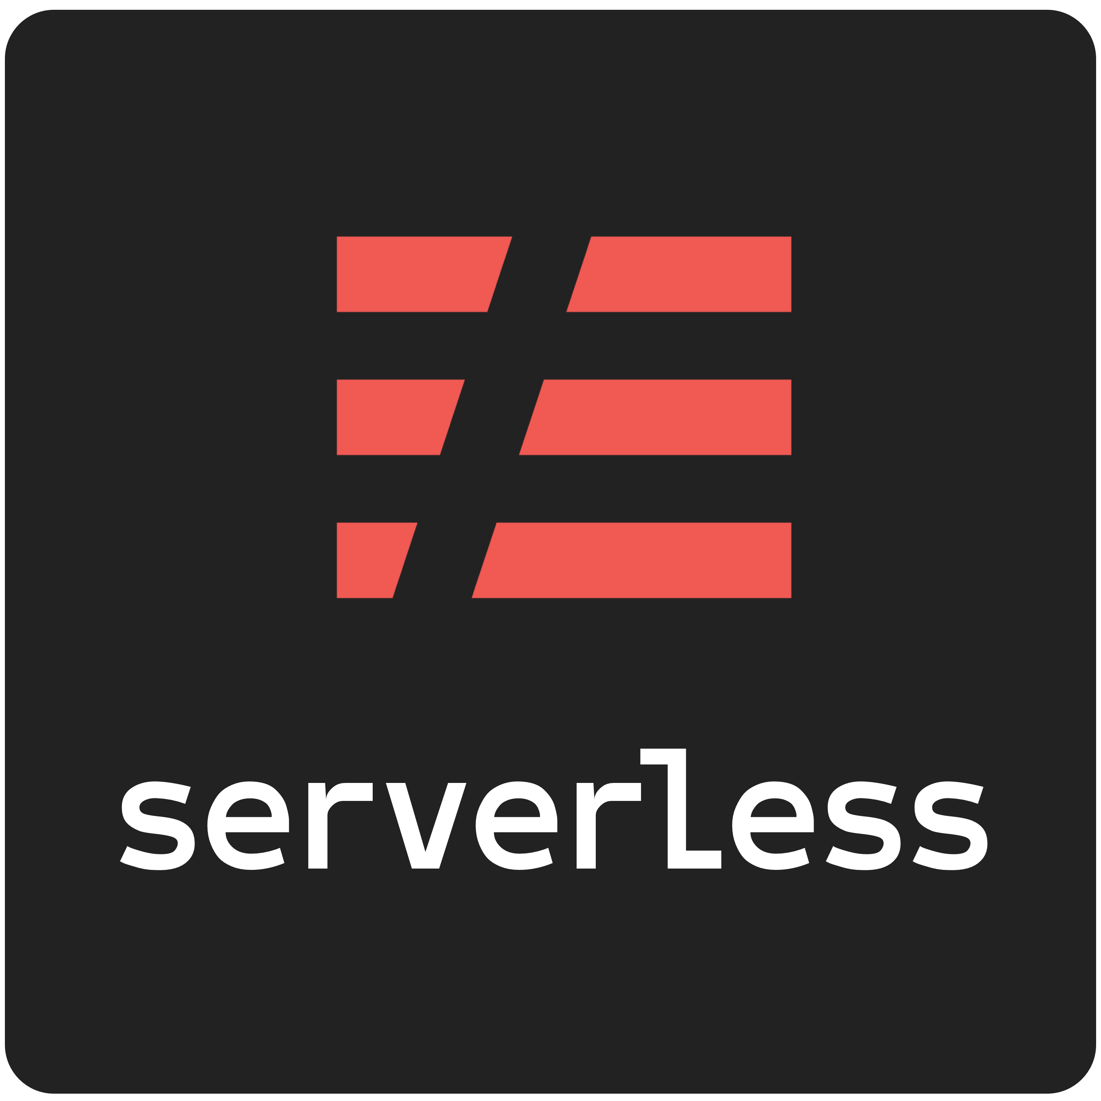
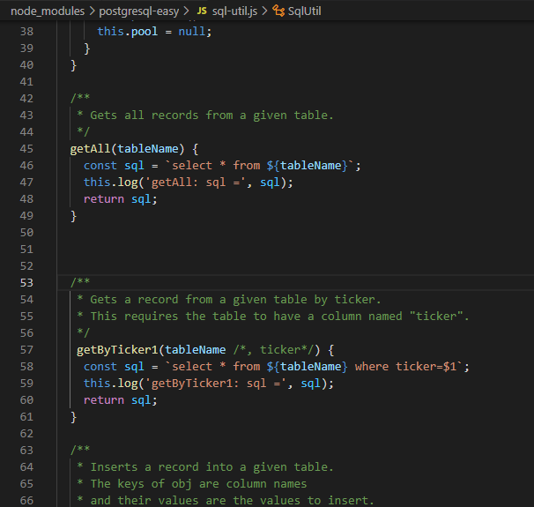
API Creation to return RDS info
Utilized “Serverless” Framework
Node.js – library to return data for our balance sheet detail viz
Postman to test API hits before pulling into front end

Slide 5
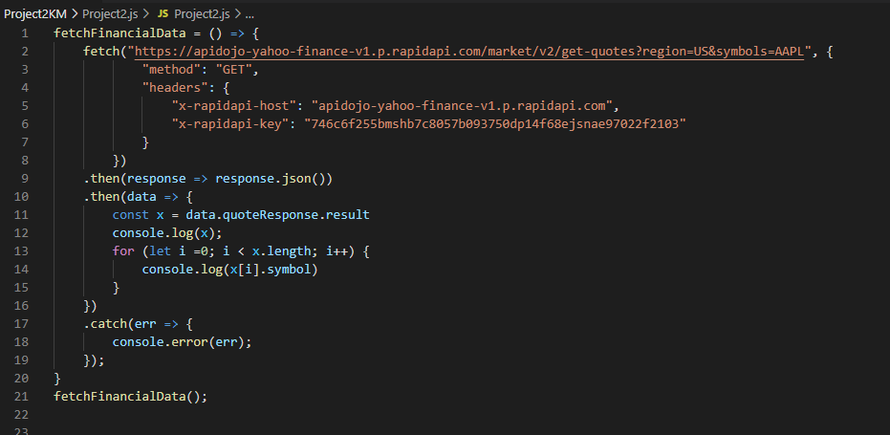
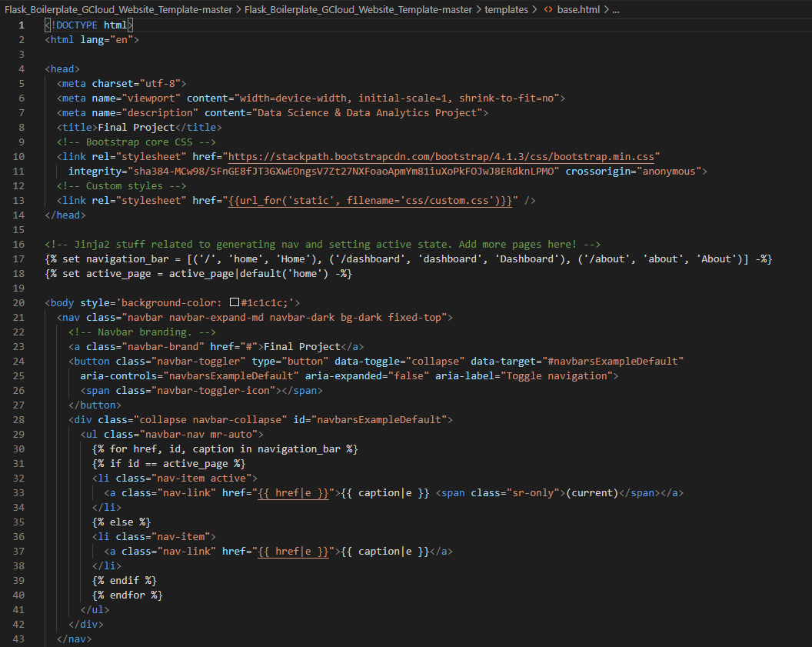
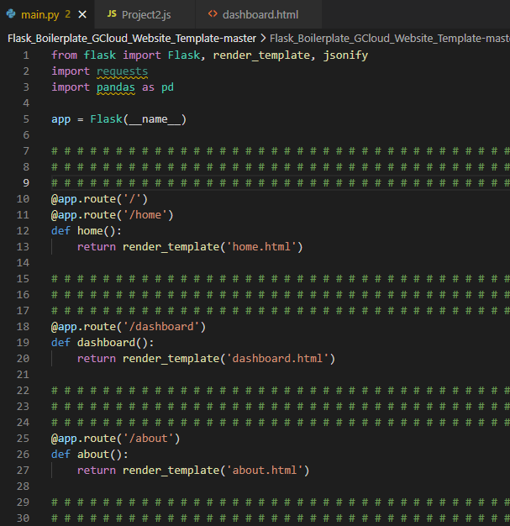
Front End Visualization & APIs
Used a boilerplate template that consisting of Javascript, CSS, & Bootstrap
Used Flask to render on the front end
Used ‘Fetch’ to hit APIs to display on screen

